Slide 1

Goodreads.com – Sentiment Analysis
Springboard Capstone Project #2
David Witten

Slide 2
Goodreads
The largest site for readers and book recommendations
Social media platform with reviews
Over 15 million scored (one through five star) reviews

Slide 3

Data
Originally scraped from Goodreads by researchers from UCSD
Almost 1.4M in the “spoiler” subset
Data from 2011 through 2017
Notes:
https://sites.google.com/eng.ucsd.edu/ucsdbookgraph/home

Slide 4

Data Cleaning: No Star Reviews
Reviews with no stars were inconsistence; some were positive, negative, or indicated the reader had not read the book yet
See an example below

Slide 5
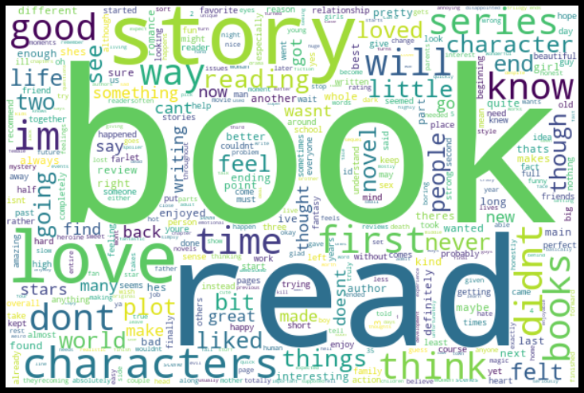
EDA: Word Cloud

Slide 6
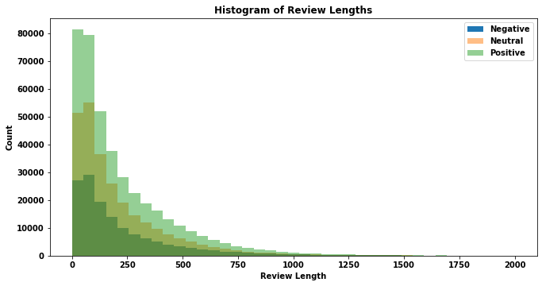
EDA: Review Length

Slide 7
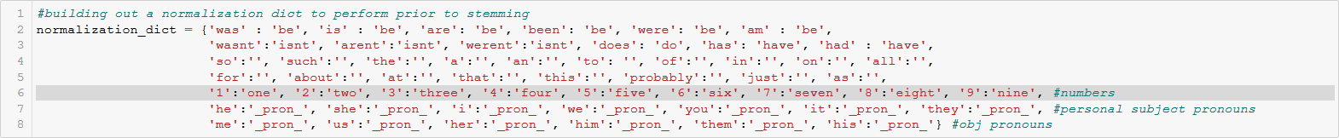
Count and TFIDFVectorizer: Text Features
Letters and numbers only
Lowercase
Custom normalization dictionary
Porter Stemmer
Words and 2-grams
Must appear in at least 400 reviews and no more than 20% of the total

Slide 8
Doc2Vec: Text Features
gensim: simple_preprocess on the text
Ran distributed bag of words (DBOW) and distributed memory (DM) models and then concatenated them for better results
Trained my own corpus using the training reviews
200 dimensions for all vectors created by the model

Slide 9
Long Short Term Memory network: Text Features
Keras preprocessing
Review into a list of 400 word indicies
I used the 300 dimension GloVe word vectors to create the embedding matrix

Slide 10
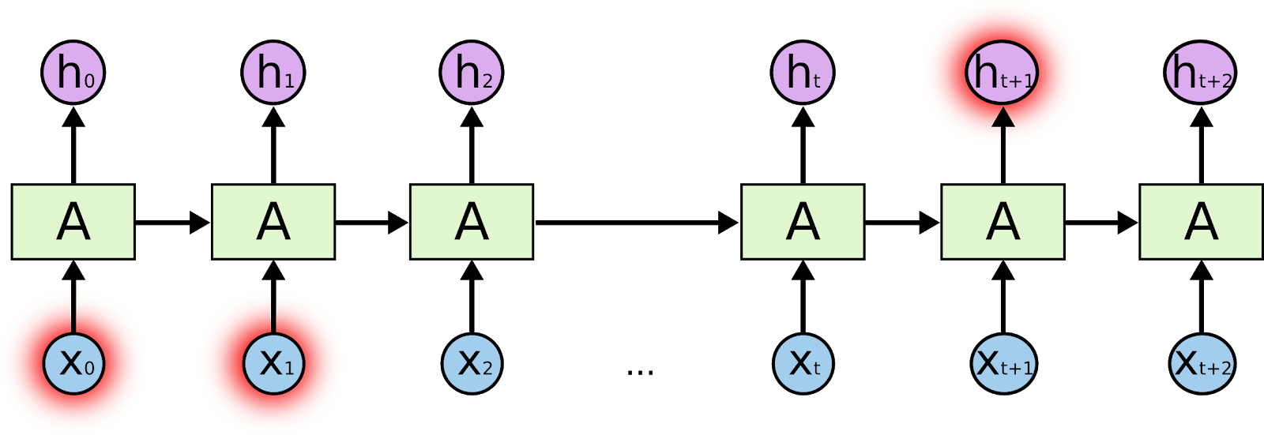
Machine Learning Models
Multinomial Logistic Regression
Fits a curve to divide different classes
Suitable for sentiment analysis
Able to handle sparse matrices
Used for CountVectorizer, TFIDF, and Doc2Vec models
LSTM network
Special type of recurrent neural network which excel at handling long-term dependencies
Should be able to learn the connections between words that are separated

Slide 11
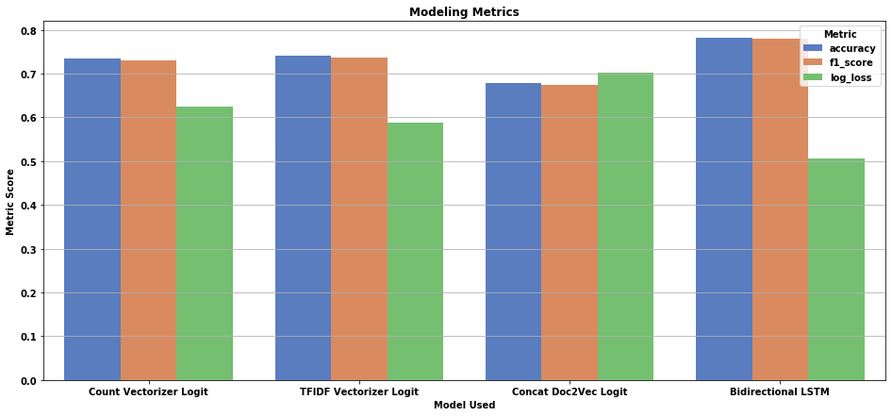
Model Comparison

Slide 12
Conclusions and Thoughts
Memory and computation time were forced constraints
The unsupervised Doc2Vec vectors offered very little in predictive power
The LSTM model excelled at prediction with a significantly lower loss
Ability to “learn” the connections between words

